Slide 1
Dr. Purushotham Muniganti
Sustainable Path For Private Sector Transportation

Slide 2
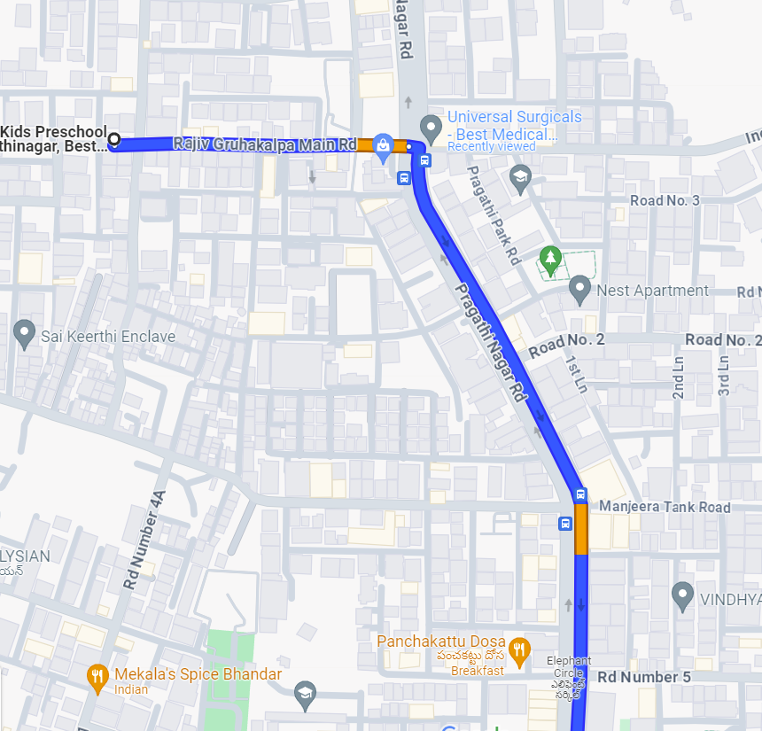
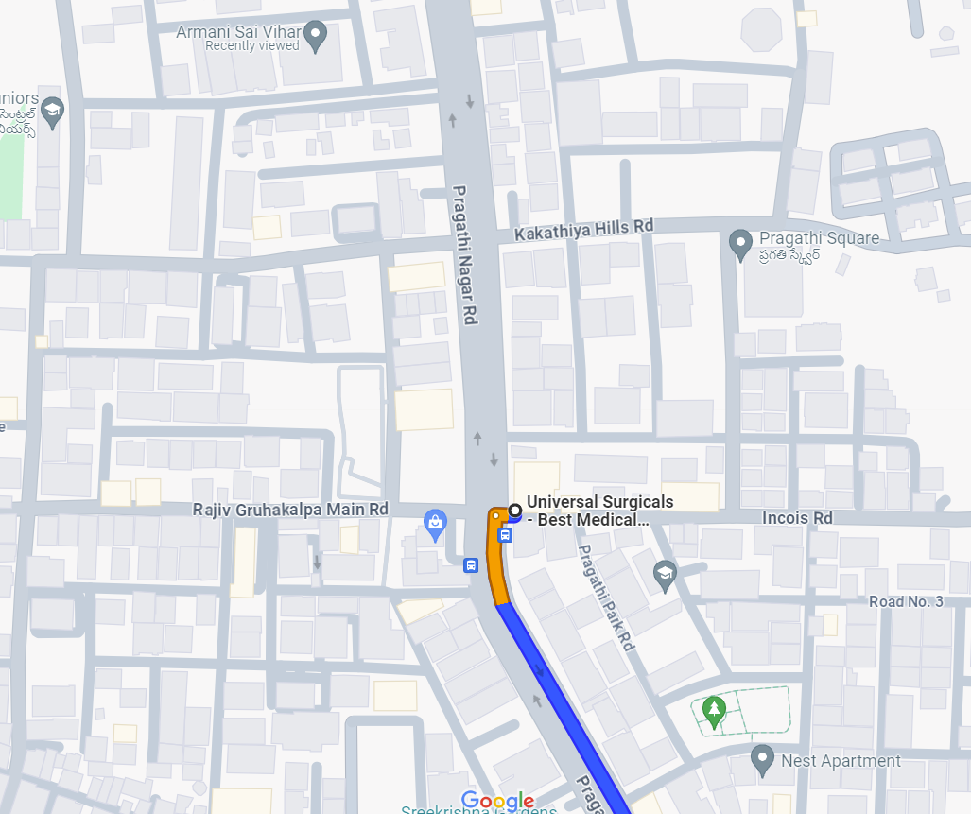
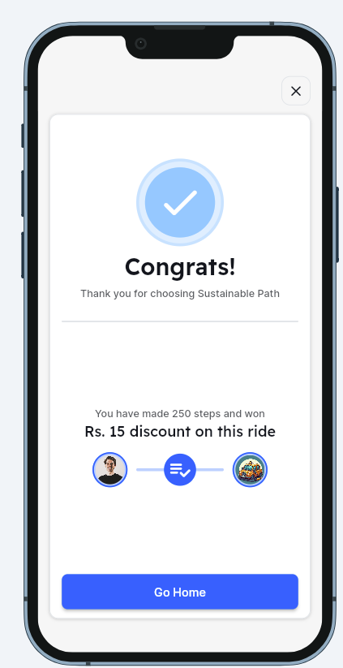
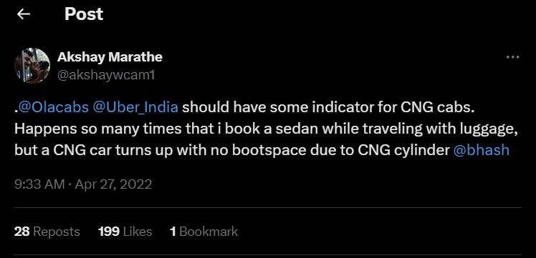




Introduction
The three main concepts-
1. Fuel type based pricing 2. Food pickup on wheels 3. Sustainable Path to reduce CO2 emission

Slide 3
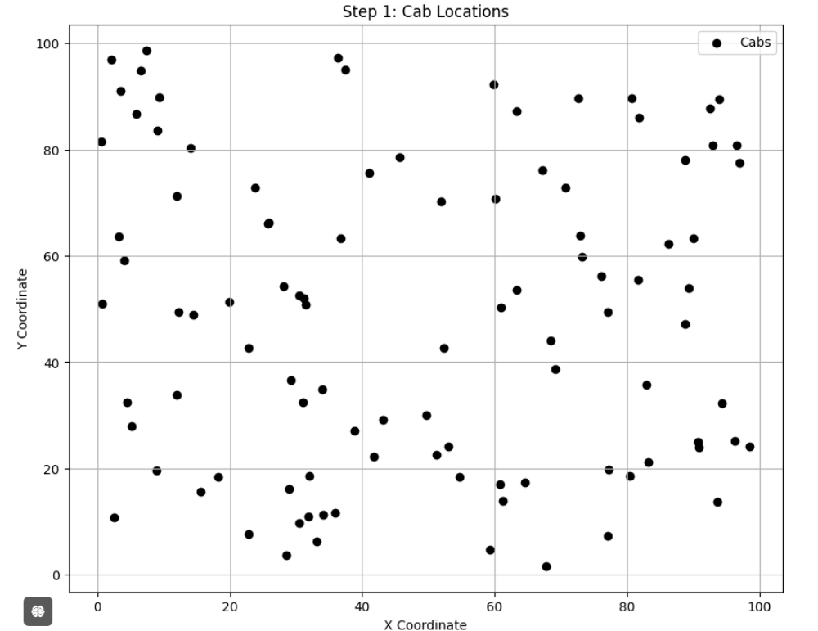
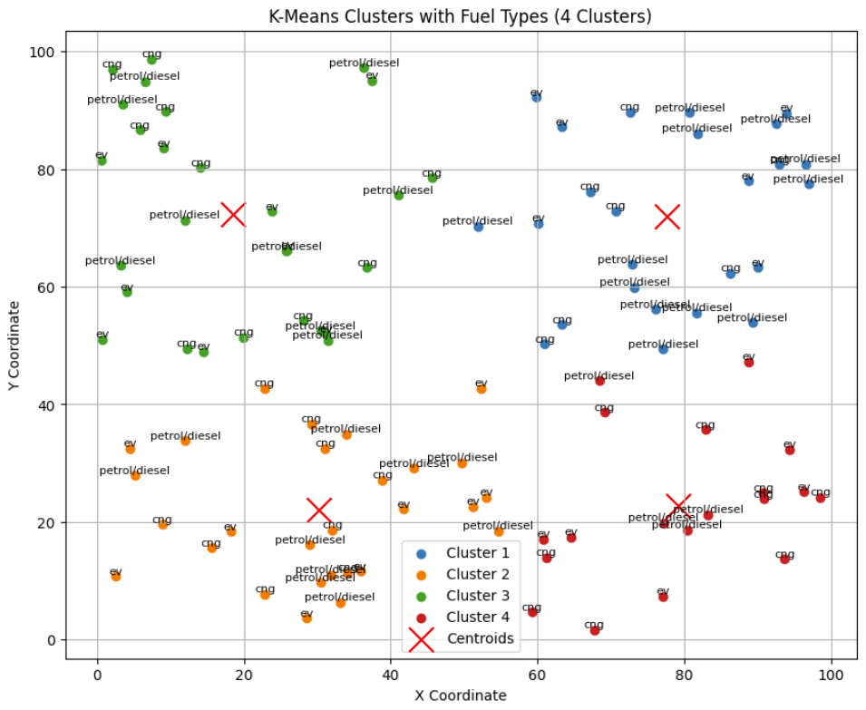
Clustering and Cab assigning

Slide 4
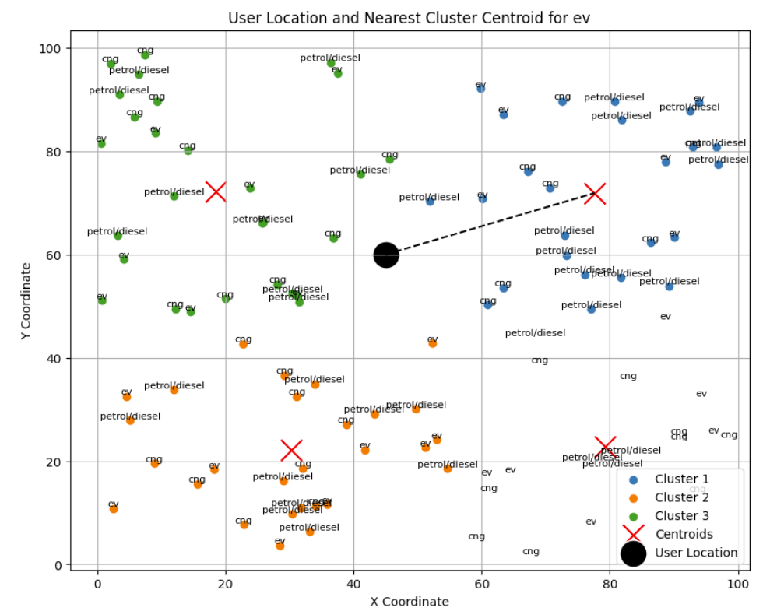
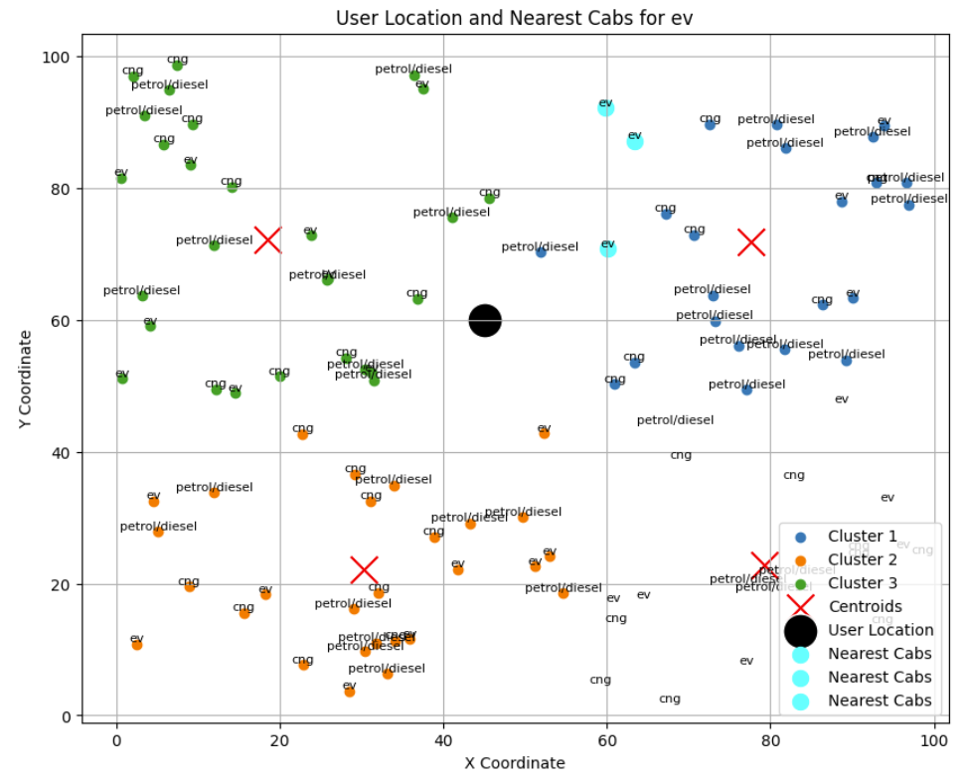
Clustering and Cab assigning

Slide 5
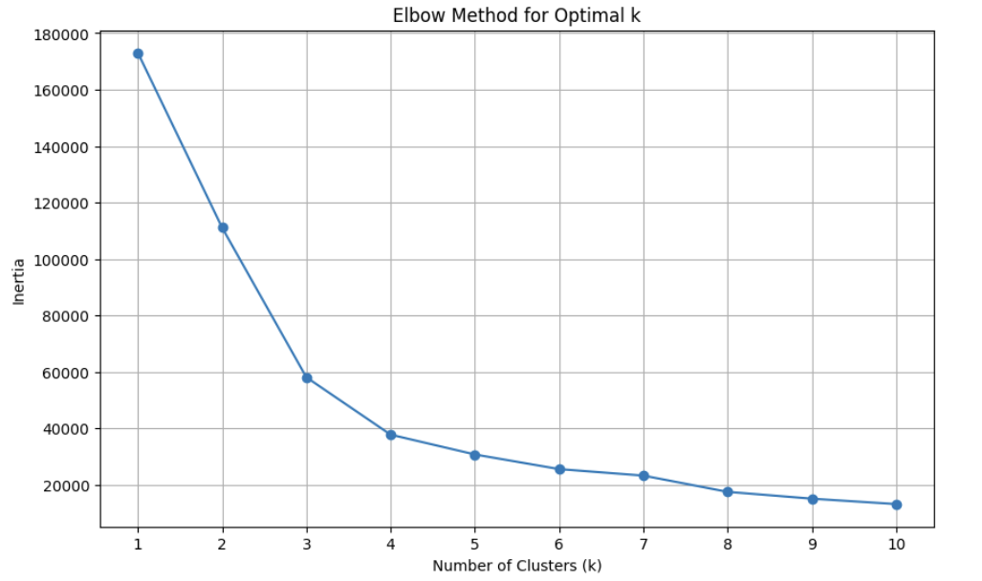
Clustering and Cab assigning

Slide 6
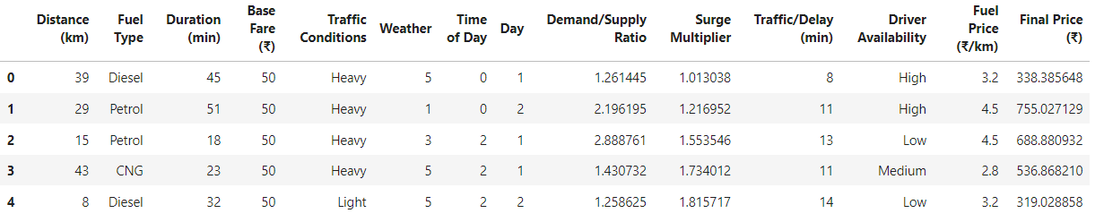
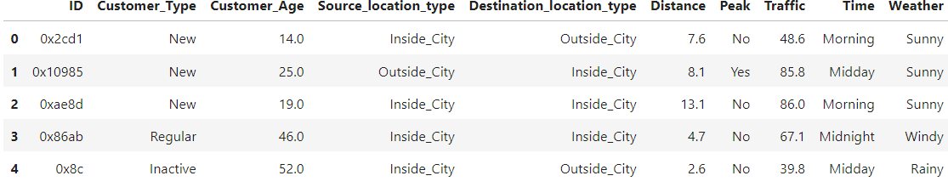
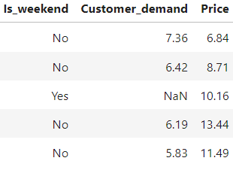
Cab fare prediction
Dataset-1
25,000x14
Dataset-2
57,202x13
Including all the features that we add it sums up to 57,202x20

Slide 7
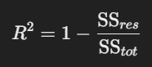
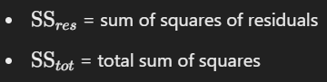
Cab fare prediction
The pre-processing of the data has been done to handle the missing values, to remove the features that doesn’t contribute to the Price feature.
Machine Learning algorithms used –
Random Forest Regressor
Gradient Boosting Regressor
Evaluations metrics
MSE
MAE
R-Square score
The best R-square score algorithm is considered

Slide 8
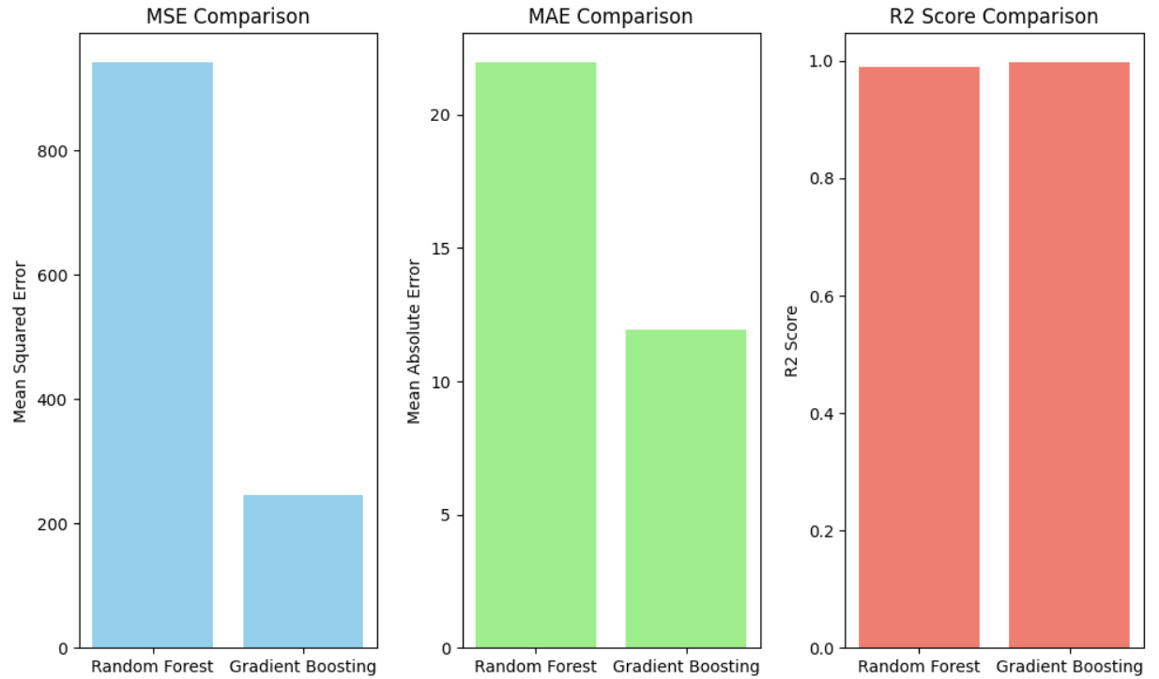
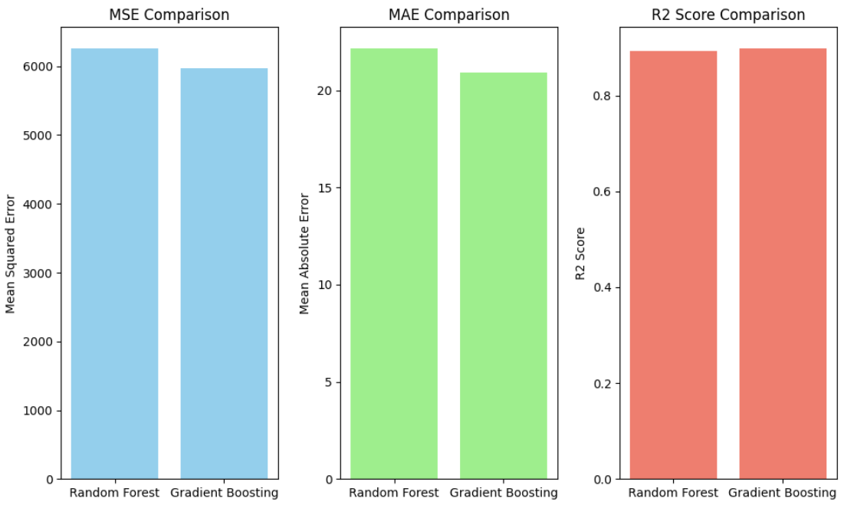
Cab fare prediction
Dataset-1
Dataset-2
The errors are very much less compared to Random Forest
R-Square Score of Gradient is higher
The errors are little less compared to Random Forest
R-Square Score of Gradient is higher
Optimal Fit- Gradient Boosting

Slide 9
The “WHY” slide
Why clustering
Why K-means
Why KNN
Why Elbow Technique
Why comparison between two datasets
Why Random Forest
Why Gradient Boosting
Why R-square

Slide 10
Future Plan
Analyze and develop a machine learning model for finding the dish preparation time
Support- https://blog.zomato.com/food-preparation-time
Unsupervised learning model for analyzing whether the user would show their willingness to Short sustainable path based on historical Data.

Slide 11
Thanking You

